Slide 1
Pico-Nym cloud using
R programming

Slide 2
Faculty Mentors :
Assist. Prof M Sakthi Balan
Assist Prof Mukesh K Jadon
Project done by-
Vamsi krishna

Slide 3

Word Cloud
It is an image composed of words used in a particular text or subject, in which the size of each word indicates its importance in that text. Eg:
Notes:
before explaining anything- this so that aim and outcome becomes clearer

Slide 4
Aim
Aim of the project is to create wordclouds which hold the meaning of the documents.
Consider a article about western state New York as an input file. And the top results that it gives is the word “New”.
Notes:
Explaining with help of example

Slide 5
Aim
We are assigning higher weightage to the words that often come together in the given data.
Our word cloud will also include these two words (with higher weightage) together.
Eg: If the article is about New York, our word cloud will include New York as a whole and not New and York as separate words.

Slide 6
Technologies Used
Languages- R
Packages- tm, SnowballC, wordcloud, Rcolorbrewer

Slide 7
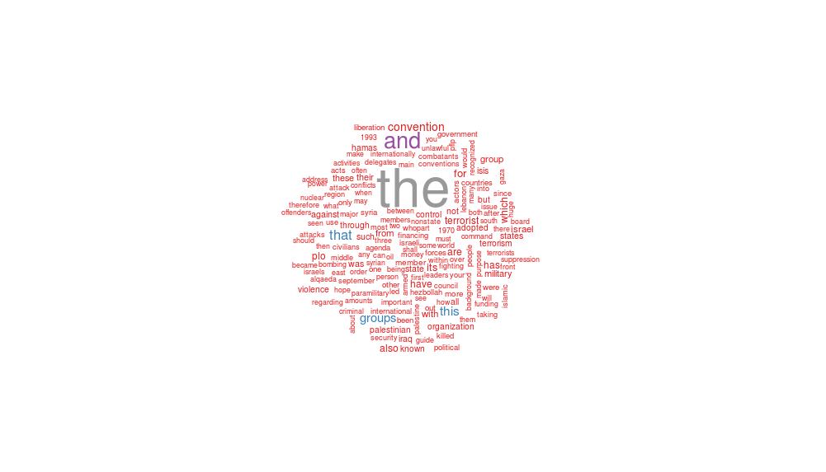
Basic Wordcloud which accounts for frequency of the word

Slide 8
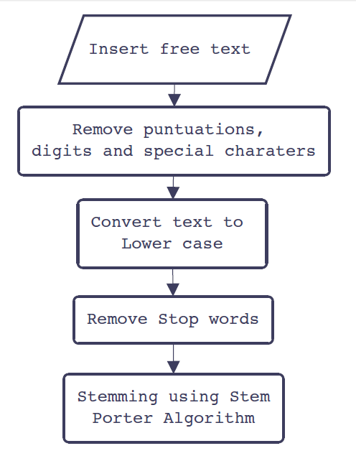
Pre-processing
> Refines the free text
> Avoids discrepancies
> File handling
> Stemming

Slide 9
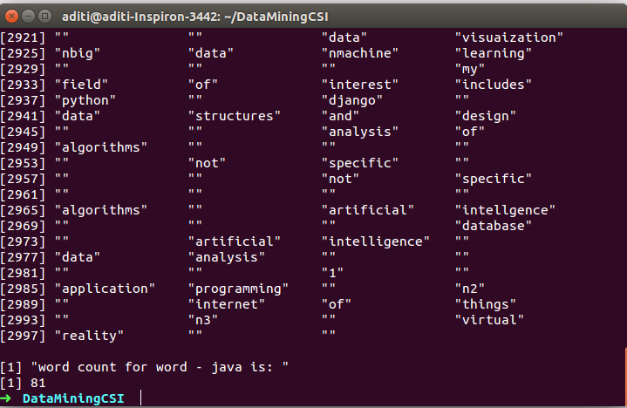
Pre-processing
This algorithm converts all words into lower case, remove certain character (punctuations etc) and divides data into vectors of single words so that it becomes easy to calculate total number of occurrences of a single word.

Slide 10
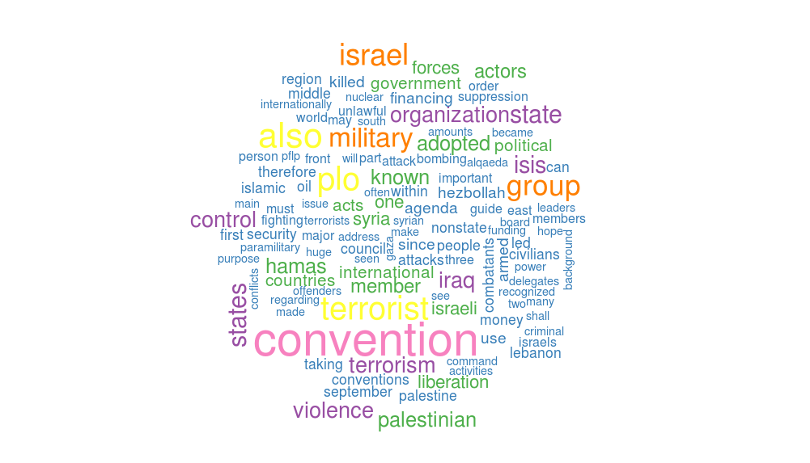
Wordcloud after Preprocessing

Slide 11
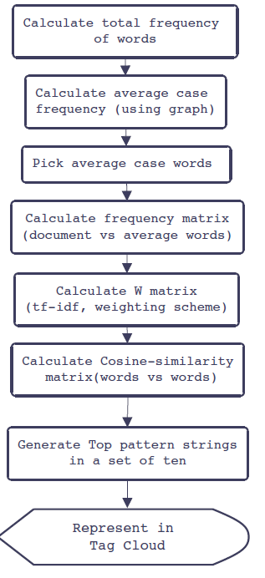
Several matrix manipulations are performed on moderately occurring unique words and a mathematical relation is deduced in form of patterns.

Slide 12
Approach:
Our approach towards the result:
1. Multi doc read and store in consecutive arrays
2. tf-idf matrix
(Term frequency - Inverse document frequency)
tf- The weight of a term that occurs in a document is simply proportional to the term frequency.
idf- This factor is incorporated which diminishes the weight of terms that occur very frequently in the document set and increases the weight of terms that occur rarely.

Slide 13
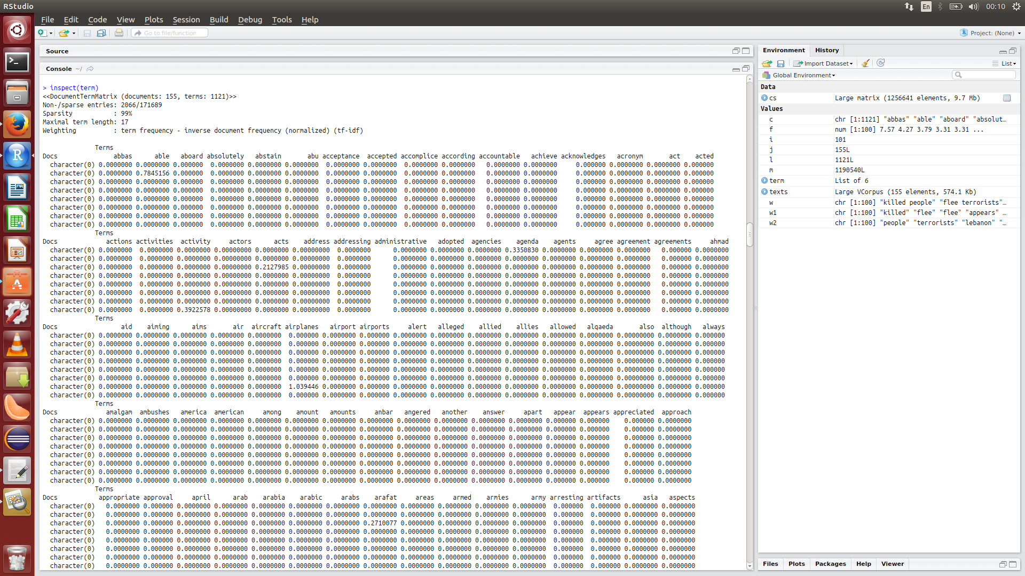
TF-IDF Matrix output

Slide 14
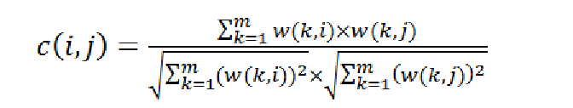
3. Cosine similarity matrix
Cosine similarity is a measure of similarity between two vectors . With help of this we will be able to know which words occur together frequently.

Slide 15
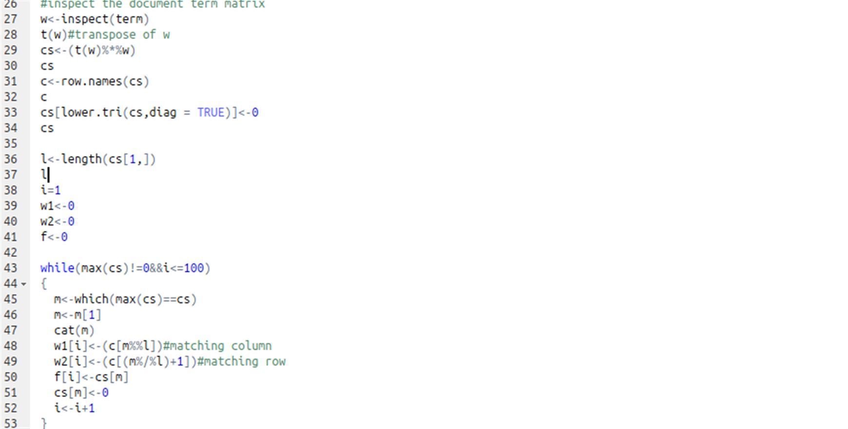
Code Snippet for Cosine Similarity

Slide 16
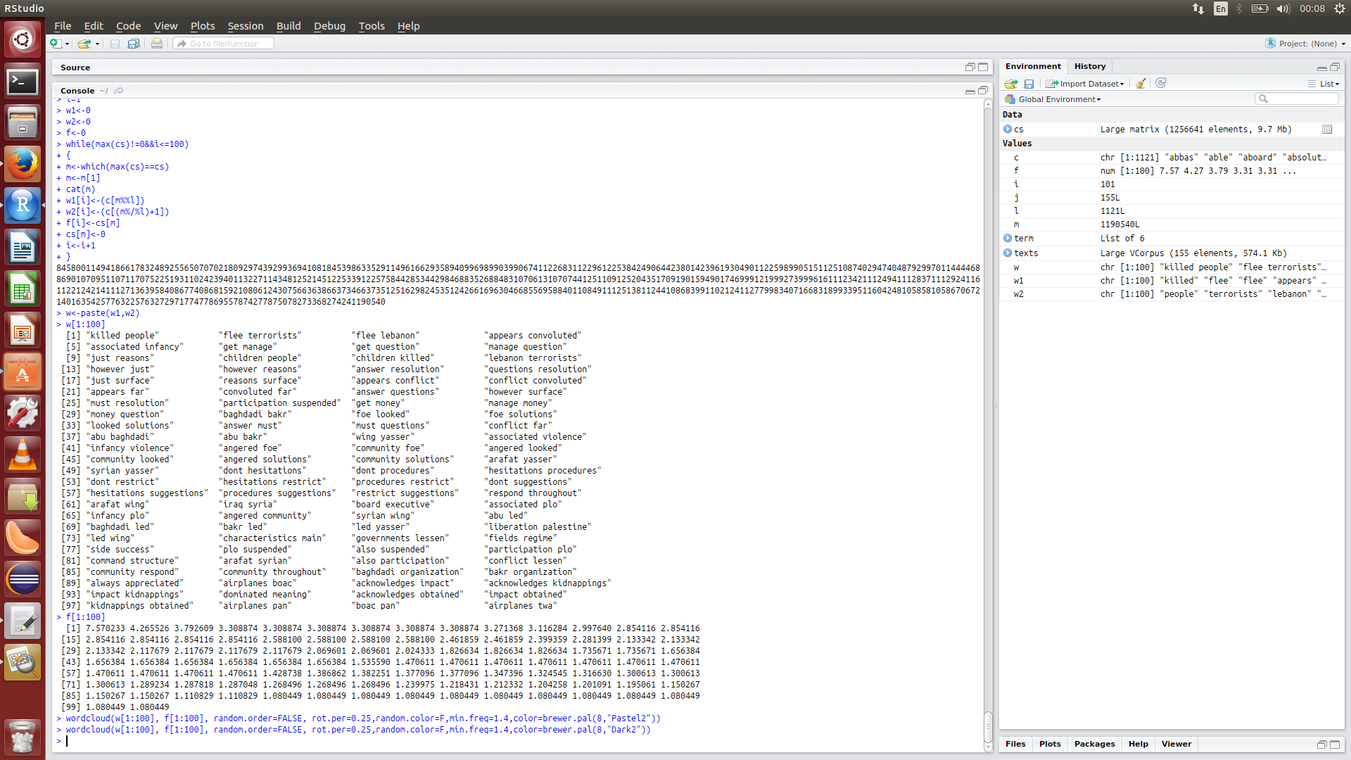
Weighted List

Slide 17
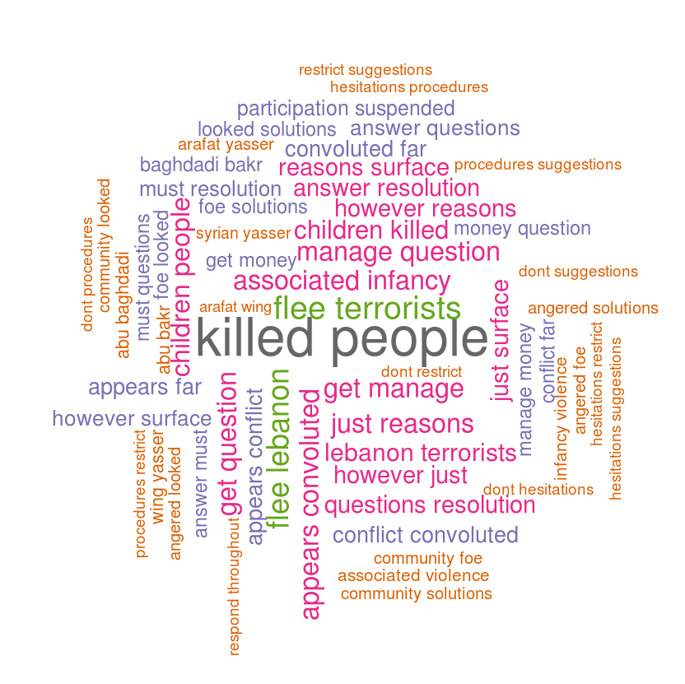
Weighted Wordcloud

Slide 18
Practical importance
For Researchers – for communicating qualitative data.
For Marketers – to highlight customer needs and pain points
For Politicians and journalist – to share the latest political pulse
For Educators – to convey important issues.
For Human resources – to engage employees by sharing common sources of frustration and show where they feel they are making the greatest impact.

Slide 19
References
R Documentation
Pico-Nym Cloud (PNC)-A Method To Devise And Peruse Semantically Related Biological Pattern .
Authors - Mukesh Kumar Jadon ,Pushkal Agarwal,Atul Nag
Published by Springer in CSI transaction on ICT Journal.

